Slide 1
Tests of Differences in Mean for Non-normal Data
NRES 776
Instructor: Heather Bryan
Oct 14, 2020

Slide 2
Learning Objectives
Detect deviations from assumption of normality
Decide what to do if your data do not meet assumptions of your test
Apply an appropriate transformation to your data
Conduct non-parametric and permutation tests for data that do not meet assumptions of normality and equal variances

Slide 3
What if data aren’t normal or variances aren’t equal?
Ignore violations
Some tests are relatively robust to violations (e.g., t-test, ANOVAs) especially with large sample sizes
Transform the data
E.g., log transformation
3. Use non-parametric methods
no assumptions of normality, outliers not a problem
4. Use a permutation test
computer generates null distribution for a test statistic and randomly rearranges the data for one of the variables

Slide 4
What if data aren’t normal or variances aren’t equal?
Ignore violations
Some tests are relatively robust to violations (e.g., t-test, ANOVAs) especially with large sample sizes

Slide 5
What if data aren’t normal or variances aren’t equal?
Ignore violations
Some tests are relatively robust to violations (e.g., t-test, ANOVAs) especially with large sample sizes
2. Transform the data
E.g., log transformation

Slide 6
What if data aren’t normal or variances aren’t equal?
Ignore violations
Some tests are relatively robust to violations (e.g., t-test, ANOVAs) especially with large sample sizes
2. Transform the data
E.g., log transformation
3. Use non-parametric methods
no assumptions of normality, outliers not a problem

Slide 7
What if data aren’t normal or variances aren’t equal?
Ignore violations
Some tests are relatively robust to violations (e.g., t-test, ANOVAs) especially with large sample sizes
Transform the data
E.g., log transformation
3. Use non-parametric methods
no assumptions of normality, outliers not a problem
4. Use a permutation test
computer generates null distribution for a test statistic and randomly rearranges the data for one of the variables

Slide 8
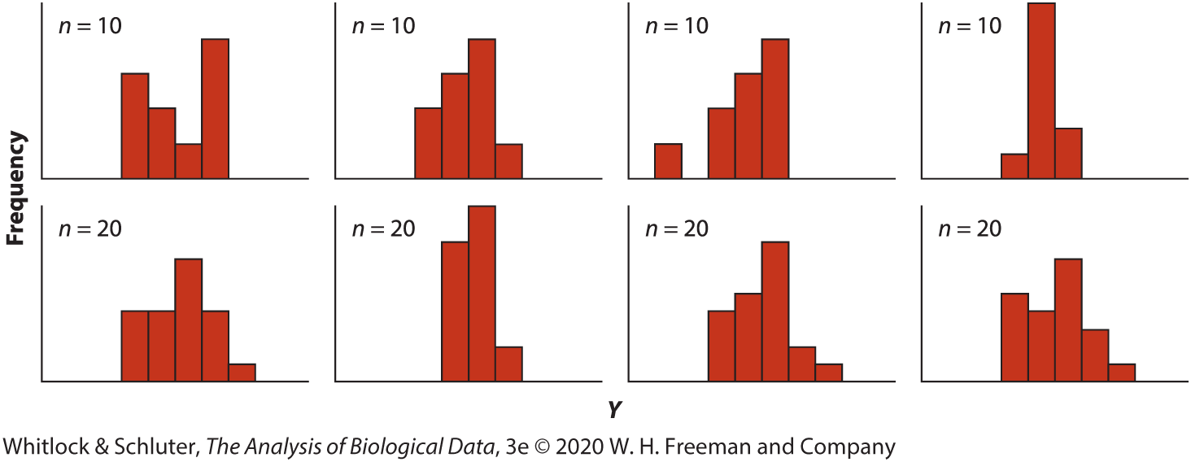
Detecting deviations from normality: Histograms
Samples drawn from normal distribution
Note variation and effect of sample size

Slide 9
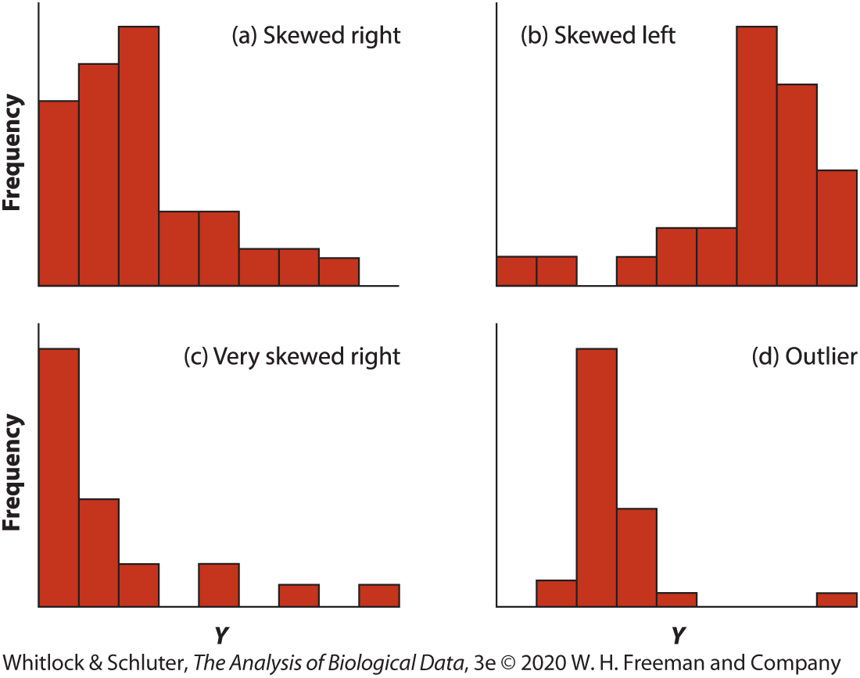
Detecting deviations from normality: Histograms
Samples drawn from non-normal distributions

Slide 10
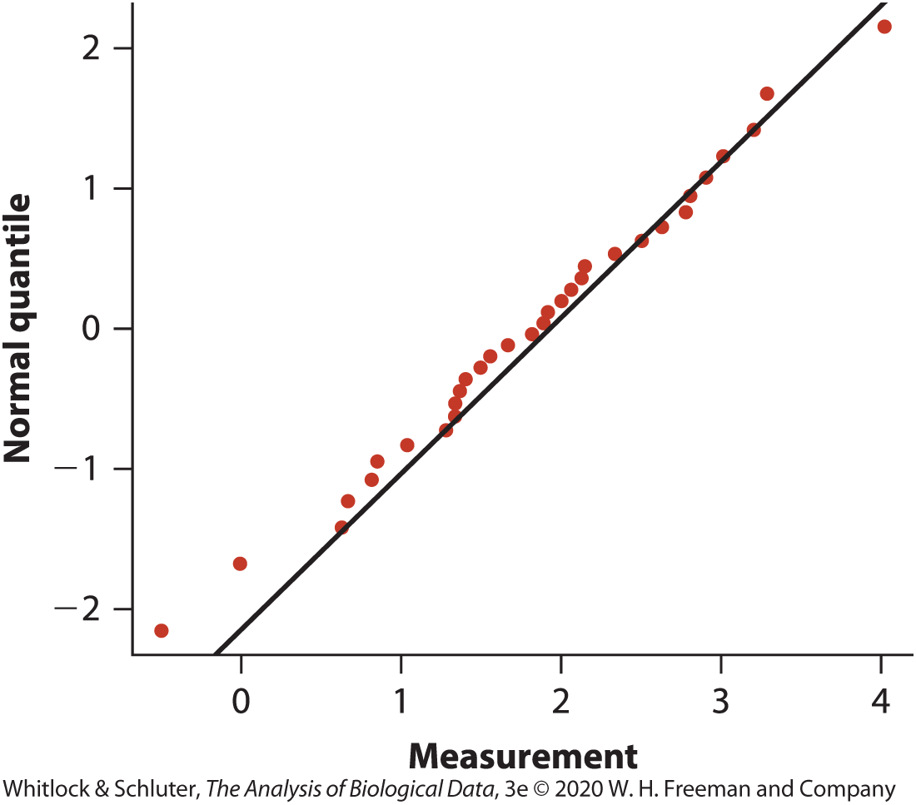
Detecting deviations from normality: Q-Q Plot
Notes:
-compares each observation in sample with what would be expected with corresponding quantile under normal distribution

Slide 11
Detecting deviations from normality: Tests
H₀: The data are sampled from a population having a normal distribution
H₁: The data are sampled from a population not having a normal distribution

Slide 12
Detecting deviations from normality: Tests
H₀: The data are sampled from a population having a normal distribution
H₁: The data are sampled from a population not having a normal distribution
E.g., Shapiro-Wilk test
Calculates the mean and standard deviation of the sample data and tests the goodness-of-fit of the data to the normal distribution with same mean and standard deviation
Performed in most software packages

Slide 13
When to ignore violations of assumptions?
Normality
Depends on robustness of test
i.e., whether violations of assumptions change the results
Comparisons of means (e.g., ANOVA, t-test) generally robust for large samples
Why?

Slide 14
When to ignore violations of assumptions?
Depends on how similar distributions of groups are
Outliers
Notes:
-if both groups have distributions as in (a), then n=30 for accurate t-test results
-would need samples size of 500 per group to get accurate answers for comparing groups with distributions in (a) and (b)
-distribution in panel c is too skewed to be analyzed with t-test
-data with outliers in (d) also should not be analyzed with t-test
-overall should use cautionary approach and turn to transformations, non-parametric methods, or permutations

Slide 15
When to ignore violations of assumptions?
Unequal variances
If n>30 in each group
balanced design
differences in standard deviation are less than 3-fold
Assumption of normality is met

Slide 16
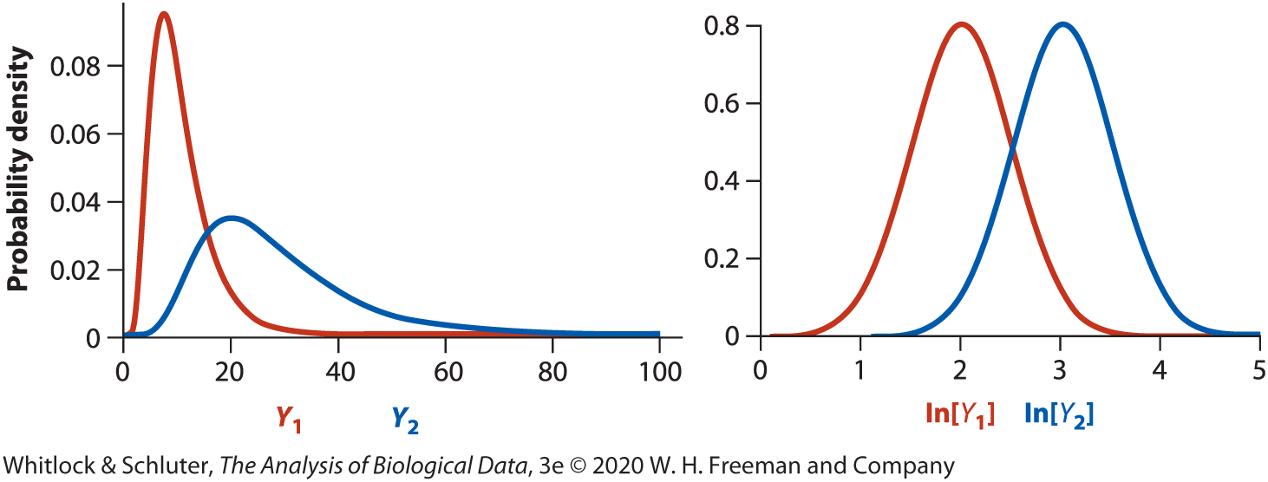
Data Transformations: log
Right-skewed data (e.g., body mass)
Population with higher mean also has higher standard deviation (e.g., elephant vs. mouse body size)
Data span orders of magnitude (e.g., abundance)
Y’ = ln[Y], back-transform Y = e^{Y’}

Slide 17

Data Transformations: arcsine
Proportions
Tend to be non-normally distributed and unequal standard deviations
p’ = arcsin$[√p]$

Slide 18

Data Transformations: square root
Count data (e.g., number eggs laid)
Y’ = $\sqrt{Y+1/2}$
Can help equalize different standard deviations between groups

Slide 19
Notes on using transformations
Often makes sense to back-transform descriptive statistics, confidence intervals, and regression coefficients that have been calculated on transformed data
E.g., For log transformation Y = e^{Y’}
Try multiple transformations, but no p-hacking! (i.e., don’t choose a different transformation because it gives significant results)

Slide 20
Nonparametric alternatives: sign test
Used for one-sample or paired t-test when normality assumption is not met

Slide 21
Nonparametric alternatives: sign test
Used for one-sample or paired t-test when normality assumption is not met
Tests whether the median of a population equals a null hypothesized value

Slide 22
Nonparametric alternatives: sign test
Used for one-sample or paired t-test when normality assumption is not met
Tests whether the median of a population equals a null hypothesized value
Assign values above the hypothesized value a + and values below a –

Slide 23
Nonparametric alternatives: sign test
Used for one-sample or paired t-test when normality assumption is not met
Tests whether the median of a population equals a null hypothesized value
Assign values above the hypothesized value a + and values below a –
Use binomial test to evaluate whether the proportion of + and – differs from p = 0.5

Slide 24
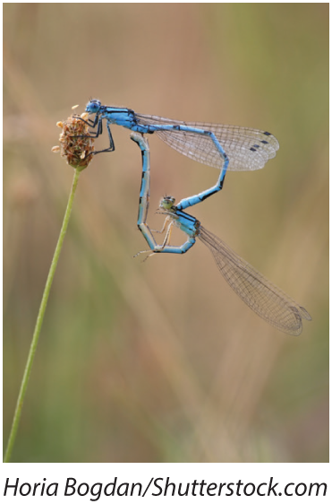
Nonparametric alternatives: sign test
E.g., sexual conflict and speciation rates

Slide 25
 | Number of species | Number of species
Taxon pair | Multiple-mating group | Single-mating group | Difference | Above (+) or below (−) zero
A | 53 | 10 | 43 | +
B | 73 | 120 | -47 | -
C | 228 | 74 | 154 | +
D | 353 | 289 | 64 | +
E | 157 | 30 | 127 | +
F | 300 | 4 | 296 | +
G | 34 | 18 | 16 | +
H | 3400 | 3500 | -100 | -
I | 20 | 1000 | -980 | -
J | 196 | 486 | -290 | -
K | 1750 | 660 | 1090 | +
L | 55 | 63 | -8 | -
M | 37 | 115 | -78 | -
N | 100 | 30 | 70 | +
O | 21,000 | 600 | 20,400 | +
P | 37 | 40 | -3 | -
Q | 7 | 5 | 2 | +
R | 15 | 7 | 8 | +
S | 18 | 6 | 12 | +
T | 240 | 13 | 227 | +
U | 15 | 14 | 1 | +
V | 77 | 16 | 61 | +
W | 15 | 14 | 1 | +
X | 85 | 6 | 79 | +
Y | 86 | 8 | 78 | +

Slide 26
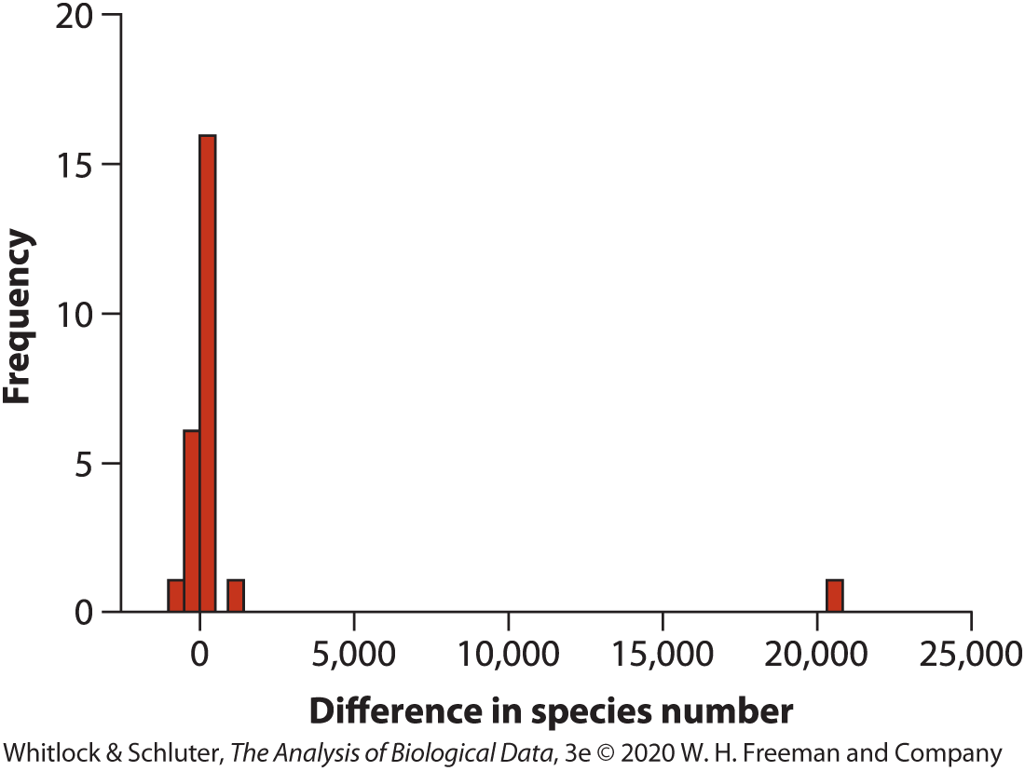
Nonparametric alternatives: sign test
E.g., sexual conflict and speciation rates

Slide 27

Nonparametric alternatives: sign test
E.g., sexual conflict and speciation rates
H₀: The median difference in number of species between insect groups is zero $(m_{d}=0)$
H₁: The median difference in number of species between these groups is not zero $(m_{d}≠0)$

Slide 28
 | Number of species | Number of species
Taxon pair | Multiple-mating group | Single-mating group | Difference | Above (+) or below (−) zero
A | 53 | 10 | 43 | +
B | 73 | 120 | -47 | -
C | 228 | 74 | 154 | +
D | 353 | 289 | 64 | +
E | 157 | 30 | 127 | +
F | 300 | 4 | 296 | +
G | 34 | 18 | 16 | +
H | 3400 | 3500 | -100 | -
I | 20 | 1000 | -980 | -
J | 196 | 486 | -290 | -
K | 1750 | 660 | 1090 | +
L | 55 | 63 | -8 | -
M | 37 | 115 | -78 | -
N | 100 | 30 | 70 | +
O | 21,000 | 600 | 20,400 | +
P | 37 | 40 | -3 | -
Q | 7 | 5 | 2 | +
R | 15 | 7 | 8 | +
S | 18 | 6 | 12 | +
T | 240 | 13 | 227 | +
U | 15 | 14 | 1 | +
V | 77 | 16 | 61 | +
W | 15 | 14 | 1 | +
X | 85 | 6 | 79 | +
Y | 86 | 8 | 78 | +

Slide 29


Nonparametric alternatives: sign test
Use binomial test
Expect p = 0.5 above and below 0
18/25 fall above 0, 7 below
$$P(x)=\left({n \atop x}\right)p^{x}{\left(1−p\right)}^{n−x}$$
$$P\left(x≤7\right)=\sum_{i=0}^{7}{\left({25 \atop i}\right)}{0.5}^{i}{\left(1−0.5\right)}^{25−i}=0.02164$$
P = 2*0.02164 = 0.043
Notes:
Binomial test tests whether a population proportion matches a null expectation for the proportion
-calculates the probability of getting a result as extreme as or more extreme than the observed proportion

Slide 30
Nonparametric alternatives: sign test
Reject H₀. Groups of insects whose females mate multiple times have more species than groups whose females mate singly, consistent with sexual-conflict hypothesis.

Slide 31
Nonparametric alternatives to two-sample t-test: Mann-Whitney U-test
Data ranked from smallest to largest
Tests whether frequency distributions of the two groups are the same

Slide 32
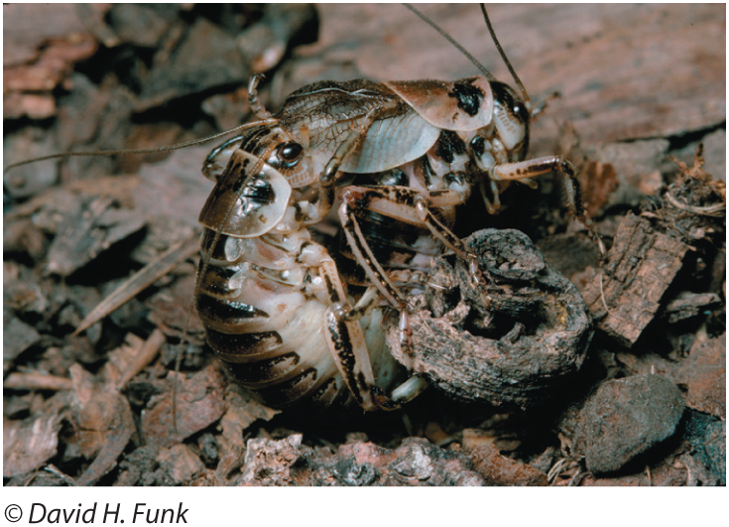
Nonparametric alternatives to two-sample t-test: Mann-Whitney U-test
E.g., sexual cannibalism in sagebrush crickets
Notes:
-male offers hind wings to females to eat during mating
-males whose wings have been eaten are less likely to be chosen by subsequent females
-Research question is: are females more likely to mate if they are hungry?
-experiment starved 11 females for two days and compared with another group of 13 females that were fed during the same period
-females were placed in a cage with a single, new male, and waiting time to mating was recorded

Slide 33
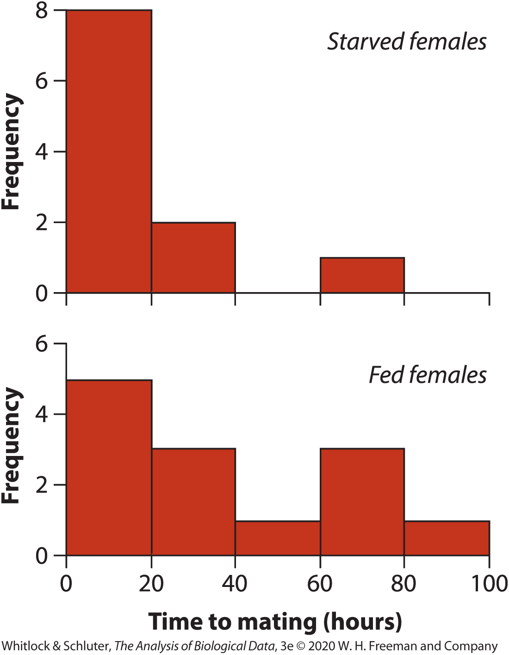
Nonparametric alternatives to two-sample t-test: Mann-Whitney U-test
Starved | Fed
1.9 | 1.5
2.1 | 1.7
3.8 | 2.4
9.0 | 3.6
9.6 | 5.7
13.0 | 22.6
14.7 | 22.8
17.9 | 39.0
21.7 | 54.4
29.0 | 72.1
72.3 | 73.6
 | 79.5
 | 88.9
Median: 13 22.8
Notes:
-median time to mating was 13 hours for starved females and 22.8 hours for fed females

Slide 34

Nonparametric alternatives to two-sample t-test: Mann-Whitney U-test
E.g., sexual cannibalism in sagebrush crickets
H₀: The distribution of time to mating is the same for female crickets that were starved and for those that were fed $(D_{1}=D_{2})$
H₁: The distribution of time to mating differs between the two groups$(D_{1}≠D_{2})$

Slide 35
Table 13.5-2, Times to mating of female crickets from both groups, ordered from smallest to largest and then ranked. Data from group 2 (fed crickets) are highlighted in red to facilitate comparison., Page 391
Group | Time to mating | Rank
2 | 1.5 | 1
2 | 1.7 | 2
1 | 1.9 | 3
1 | 2.1 | 4
2 | 2.4 | 5
2 | 3.6 | 6
1 | 3.8 | 7
2 | 5.7 | 8
1 | 9.0 | 9
1 | 9.6 | 10
1 | 13.0 | 11
1 | 14.7 | 12
1 | 17.9 | 13
1 | 21.9 | 14
2 | 22.6 | 15
2 | 22.8 | 16
1 | 29.0 | 17
2 | 39.0 | 18
2 | 54.4 | 19
2 | 72.1 | 20
1 | 72.3 | 21
2 | 73.6 | 22
2 | 79.5 | 23
2 | 88.9 | 24

Slide 36




Nonparametric alternatives to two-sample t-test: Mann-Whitney U-test
Sort data in both groups from smallest to largest and assign ranks
Calculate the rank sum for one of the groups (e.g., starved group)
R1 = 3 + 4 + 7 + 9 + 10 + 11 + 12 + 13 + 14 + 17 + 21 = 121
3) Calculate U1: number of times rank in group 1 is smaller than group 2
$U_{1}=n_{1}n_{2}+\frac{n_{1}(n_{1}+1)}{2}$ - $R_{1}$
$$U_{2}=n_{1}n_{2}−U_{1}$$
$U_{1}=11(13) +\frac{11 (11+1)}{2}$ - $121$= 88
$$U_{2}=11\left(13\right)−88=55$$

Slide 37
Nonparametric alternatives to two-sample t-test: Mann-Whitney U-test
4) Choose the larger of U₁, U₂ (88)
5) Determine the p-value from Mann-Whitney U Distribution U_{0.05(2),11,13} = 106, p>0.05
6) Fail to reject H₀. Insufficient evidence that the distribution of time to mating is different between starved and fed female crickets.

Slide 38
Assumptions of non-parametric tests
Random sampling
Make sure you know what you are testing (e.g., Mann-Whitney U test compares distributions, not necessarily locations unless distributions have same shape)

Slide 39
Type I and II error rates of nonparametric methods
Parametric and non-parametric approaches generally have similar Type I error rates (probability of rejecting a true null hypothesis) when assumptions are met
Type I error rates go up for non-parametric tests when assumptions are not met
Non-parametric tests have lower power (ability to detect a difference if there is one), so if assumptions are met, it’s better to use parametric tests

Slide 40
Permutation tests
Computer-intensive method for testing hypotheses when data are non-normal
Can be used to test a variety of hypotheses (e.g., two-sample tests, associations between categorical or numerical variables, and more complex analyses)
Involve randomly re-arranging (permuting) data many times and comparing the observed test statistic with what would be expected based on a random sample

Slide 41
Table 13.8-1, Times to mating (in hours) of female sagebrush crickets that were recently starved or fed. Data from the two treatments are color-coded to more easily identify the origin of each value later in Table 13.8-2., Page 396
Treatment | Time (hours) | Treatment | Time (hours)
Starved | 1.9 | Fed | 1.5
Starved | 2.1 | Fed | 1.7
Starved | 3.8 | Fed | 2.4
Starved | 9.0 | Fed | 3.6
Starved | 9.6 | Fed | 5.7
Starved | 13.0 | Fed | 22.6
Starved | 14.7 | Fed | 22.8
Starved | 17.9 | Fed | 39.0
Starved | 21.7 | Fed | 54.4
Starved | 29.0 | Fed | 72.1
Starved | 72.3 | Fed | 73.6
 |  | Fed | 79.5
 |  | Fed | 88.9
Mean | 17.73 | Mean | 35.98

Slide 42
Permutation test example
H₀: Mean time to mating is the same for female crickets that were starved and for those that were fed
H₁: Mean time to mating differs between groups

Slide 43
Table 13.8-1, Times to mating (in hours) of female sagebrush crickets that were recently starved or fed. Data from the two treatments are color-coded to more easily identify the origin of each value later in Table 13.8-2., Page 396
Treatment | Time (hours) | Treatment | Time (hours)
Starved | 1.9 | Fed | 1.5
Starved | 2.1 | Fed | 1.7
Starved | 3.8 | Fed | 2.4
Starved | 9.0 | Fed | 3.6
Starved | 9.6 | Fed | 5.7
Starved | 13.0 | Fed | 22.6
Starved | 14.7 | Fed | 22.8
Starved | 17.9 | Fed | 39.0
Starved | 21.7 | Fed | 54.4
Starved | 29.0 | Fed | 72.1
Starved | 72.3 | Fed | 73.6
 |  | Fed | 79.5
 |  | Fed | 88.9
Mean | 17.73 | Mean | 35.98

Slide 44

Permutation test example
H₀: Mean time to mating is the same for female crickets that were starved and for those that were fed
H₁: Mean time to mating differs between groups
Original Sample
${\overline{Y}}_{1}$-${\overline{Y}}_{2}$ = 17.73-35.98 = -18.26

Slide 45
Table 13.8-2, Outcome of a single permutation. Response measurements (time to mating) are color-coded as in Table 13.8-1 to indicate their original groups., Page 397
Treatment | Time (hours) | Treatment | Time (hours)
Starved | 3.8 | Fed | 14.7
Starved | 9.0 | Fed | 21.7
Starved | 3.6 | Fed | 1.7
Starved | 79.5 | Fed | 2.1
Starved | 17.9 | Fed | 1.5
Starved | 22.8 | Fed | 2.4
Starved | 54.4 | Fed | 5.7
Starved | 13.0 | Fed | 39.0
Starved | 9.6 | Fed | 29.0
Starved | 1.9 | Fed | 72.1
Starved | 22.6 | Fed | 88.9
 |  | Fed | 72.3
 |  | Fed | 73.6
Mean | 21.65 | Mean | 32.67

Slide 46

Permutation test example
H₀: Mean time to mating is the same for female crickets that were starved and for those that were fed
H₁: Mean time to mating differs between groups
Original sample:
${\overline{Y}}_{1}$-${\overline{Y}}_{2}$ = 17.73-35.98 = -18.26
Permuted sample:
${\overline{Y}}_{1}$-${\overline{Y}}_{2}$ = 21.65-32.67 = -11.02

Slide 47
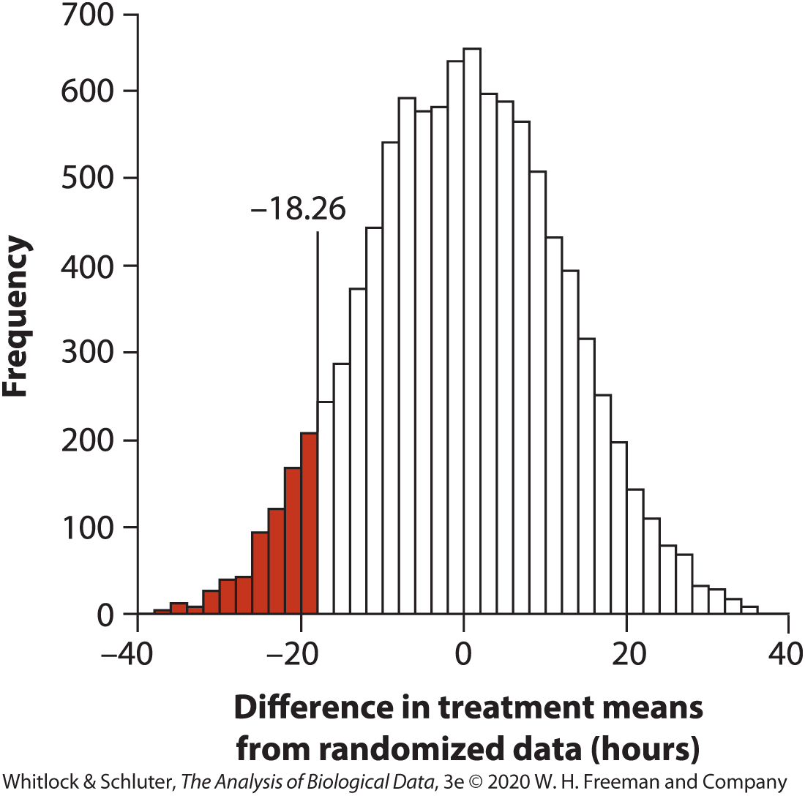
Permutation test example
712/1000 permutations led to observed difference in means of -18.26 or more extreme
P = 2*0.0712 = 0.142
Fail to reject H₀

Slide 48
Assumptions of permutation tests
Few assumptions, widely applicable
Random sample
Distribution of variable must have same shape in both populations
Lower power than parametric tests when sample sizes are small, but more powerful than Mann-Whitney U test
Similar power as parametric tests when sample sizes are large

Slide 49
Summary
What to do if assumptions of your test are violated?
Ignore minor violations if statistical method is robust
Transform data to better meet assumptions
Use a non-parametric test
Use a permutation test

